Slide 1
Poisson Processes
1

Slide 2
Outline
Introduction to Poisson Processes
Definition of arrival process
Definition of renewal process
Definition of Poisson process
Properties of Poisson processes
Inter-arrival time distribution
Waiting time distribution
Superposition and decomposition
Non-homogeneous Poisson processes (relaxing stationary)
Compound Poisson processes (relaxing single arrival)
Modulated Poisson processes (relaxing independent)

Slide 3
Stochastic Process
A stochastic process X = {X(t ), t ∈T } is a collection of random variables. That is, for each t ∈T, X(t ) is a random variable.
The index t is often interpreted as “time” and, as a result, we refer to X(t ) as the “state” of the process at time t.
When index set T of process X is a countable set
=> X is a discrete-time stochastic process
When index set T of process X is a continuum (uncountable)
=> X is a continuous-time stochastic process

Slide 4
Stochastic Process (con’t)
Four types of stochastic processes
─ Discrete Time with Discrete State Space
─Continuous Time with Discrete State Space
─Discrete Time with Continuous State Space
─Continuous Time with Continuous State Space

Slide 5
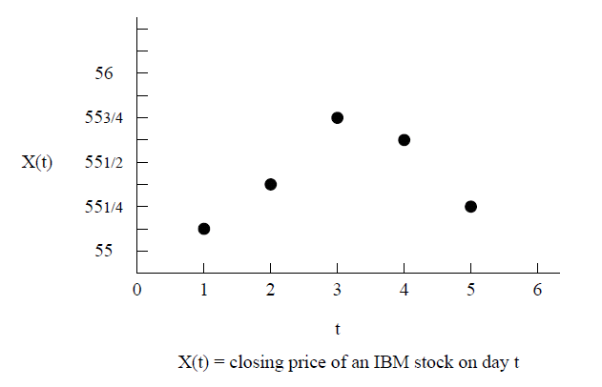
Discrete Time with Discrete State Space

Slide 6
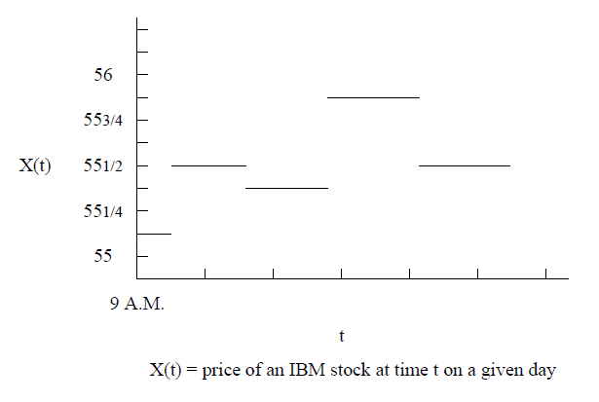
Continuous Time with Discrete State Space
uncountable real value

Slide 7
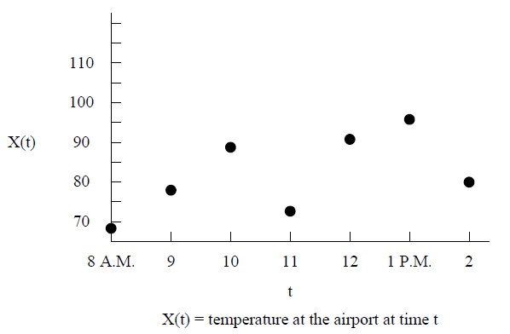
Discrete Time with Continuous State Space
uncountable real value
(every hour on the hour )

Slide 8
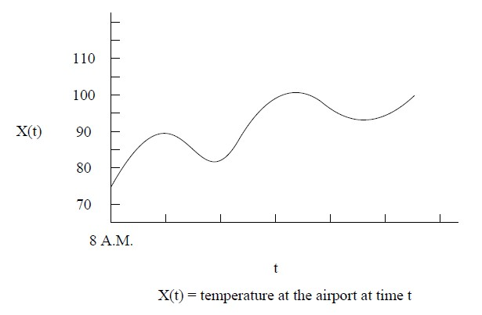
Continuous Time with Continuous State Space

Slide 9
Two Structural Properties of Stochastic Processes
Independent increment : if for all t₀ < t₁ < t₂ < . . . < t_{n} in the process X = {X(t), t ≥ 0}, random variables X(t₁ ) − X (t₀), X(t₂) − X (t₁ ),
. . . , X(t_{n}) − X (t_{n-1}) are independent
⇒ the magnitudes of state change over non-overlapping time intervals are mutually independent
Stationary increment : if the random variable X (t + s) − X (t) has the same probability distribution for all t and any s > 0,
⇒ the probability distribution governing the magnitude of state change depends only on the difference in the lengths of the time indices and is independent of the time origin used for the indexing
variable
(t + s )- t
t

Slide 10
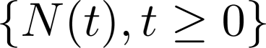

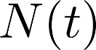
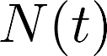
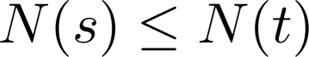
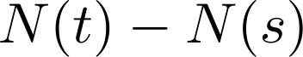
Counting Processes
A stochastic process is said to be a counting process
if represents the total number of “events” that have occurred
up to time t.
From the definition we see that for a counting process satisfy:
must
1.
2.
≥ 0.
is integer valued.
If s < t, then
For s < t ,
equals the number of events that have
occurred in the interval (s, t ].
Ex. 1 number of cars passing by
Ex. 2 number of home runs hit by a baseball player
10

Slide 11
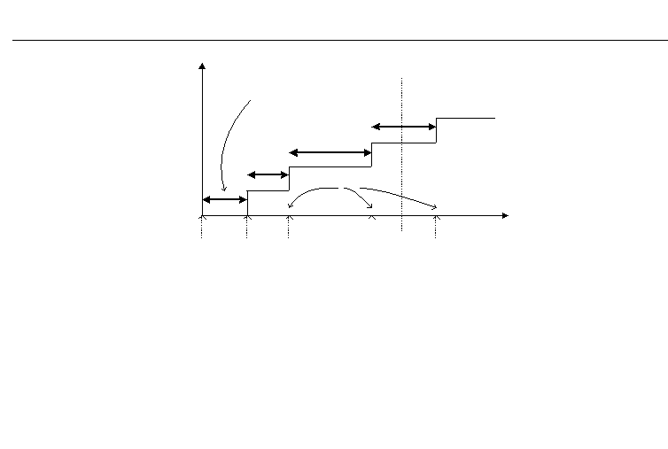
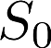
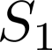
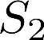
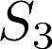
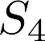
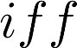
Counting Processes
Inter-arrival time
X₃
arrival epoch
X₂
X₁
t

Slide 12
Three Types of Counting Processes
Arrival Process:
Renewal Process:
Poisson Process:

Slide 13
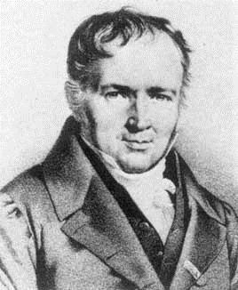
Siméon Denis Poisson
Born: 6/21/1781-Pithiviers, France
 Died: 4/25/1840-Sceaux, France
“Life is good for only two things:
discovering mathematics and
teaching mathematics.”

Slide 14
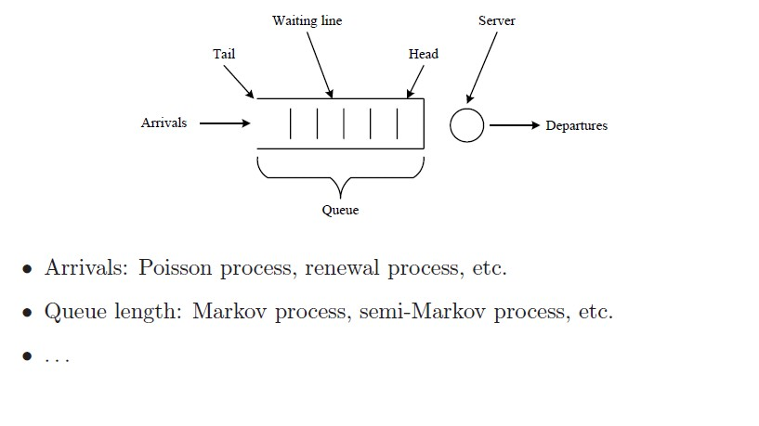
A Single Server Queue
14

Slide 15
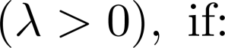
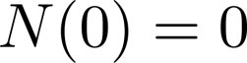
Definition 1: Poisson Processes
1.
2. Independent increments
3. The number of events in any interval of length t is Poisson distributed with mean λt. That is, for all s, t ≥ 0
dependent on t, independent on s ⬅stationary increments property
15

Slide 16


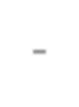


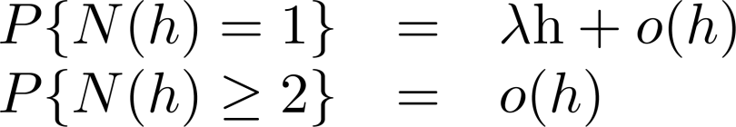
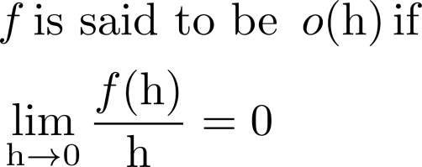
Definition 2: Poisson Processes
1.
2. Independent increments
relaxed ⇒ Modulated Poisson Process
3. Stationary increments
relaxed ⇒ Non-homogeneous Poisson Process
4. Single arrival
relaxed ⇒ Compound Poisson Process

Slide 17


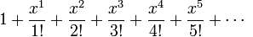
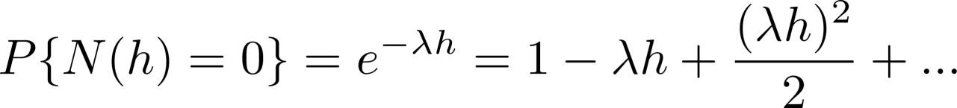
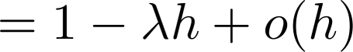
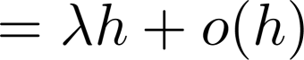
Theorem: Definition 1 and Definition 2 are equivalent
Proof: We show that Definition 1 implies Definition 2
The Taylor series for the exponential function e^{x} at a = 0 is
e^{x} =

Slide 18
From condition (3) of Definition 1, the number of events in any interval of
length t is Poisson distributed with mean λt.
=> We know that N(t) also has stationary increments .
＃

Slide 19
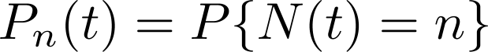
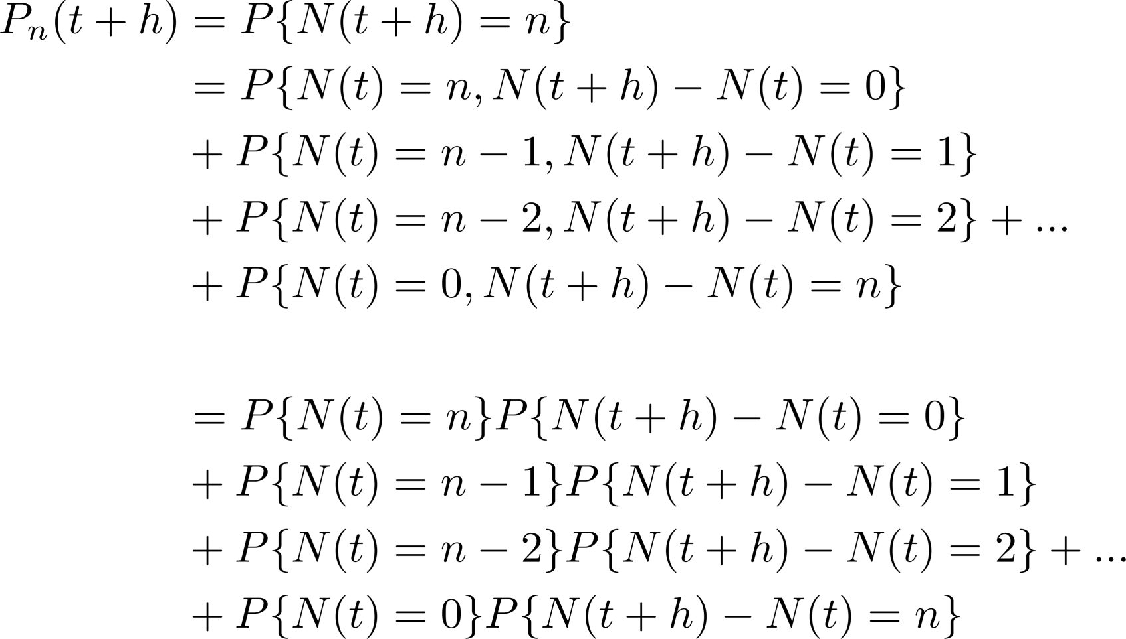

Theorem: Deﬁnitions 1 and 2 are equivalent (con’t)
Proof: We show that Definition 2 implies Definition 1
Let
Independent
P {N(h) = 0}
P {N(h) = 1}

Slide 20
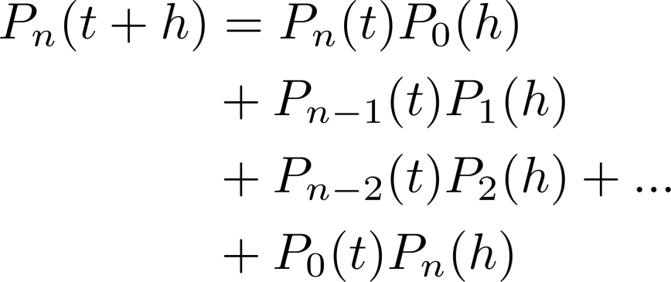
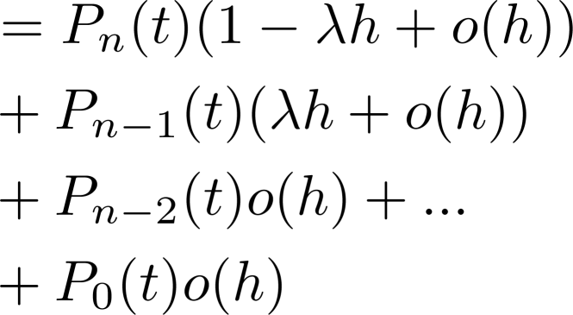
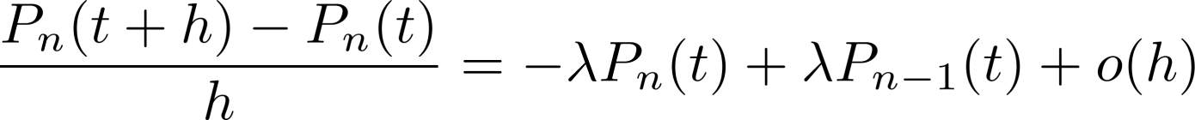

20

Slide 21
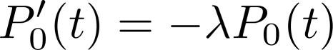
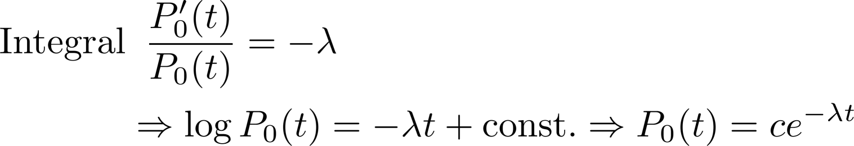
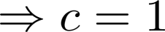
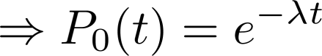
∵

Slide 22
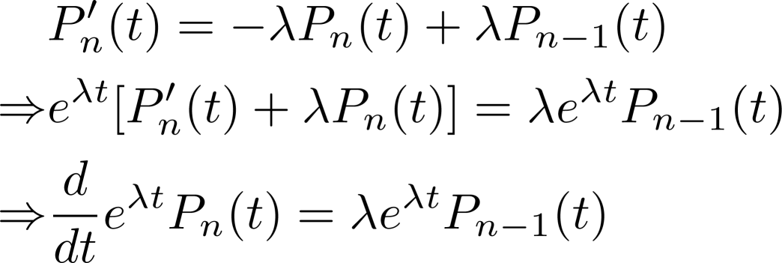
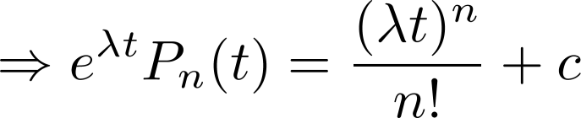
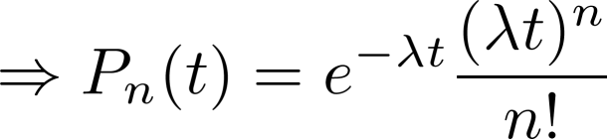
integral
∵
＃

Slide 23
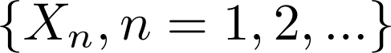
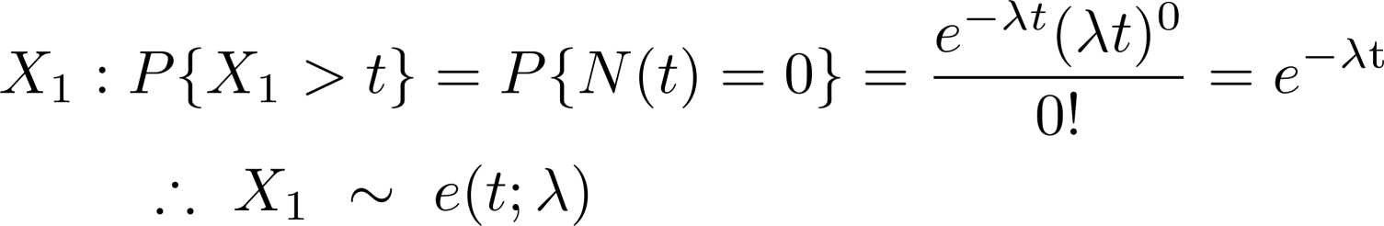
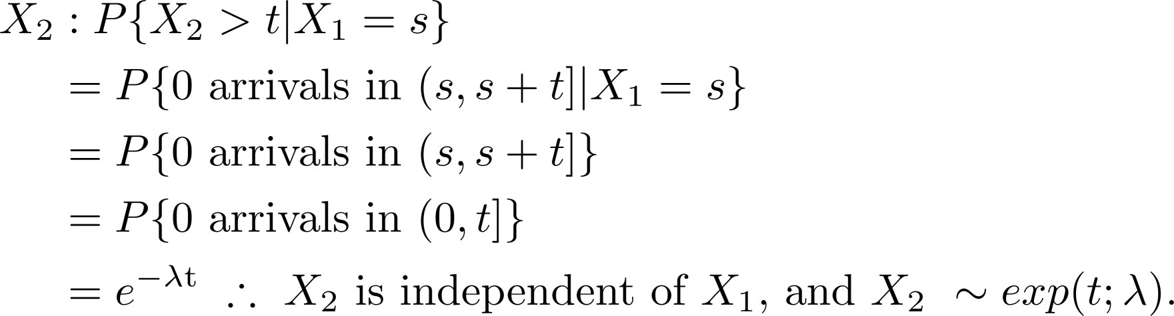
The Inter-Arrival Time Distribution
Theorem
Poisson Processes have exponential inter-arrival time distribution, i.e., are i.i.d. and exponentially distributed with parameter λ ( i.e., mean inter-arrival time = 1/ λ ).
Proof:
by independent increment
by stationary increment
( The procedure repeats for the rest of Xi‘s. )

Slide 24
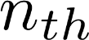
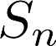
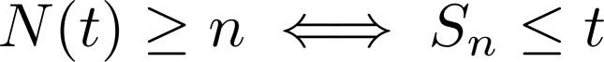
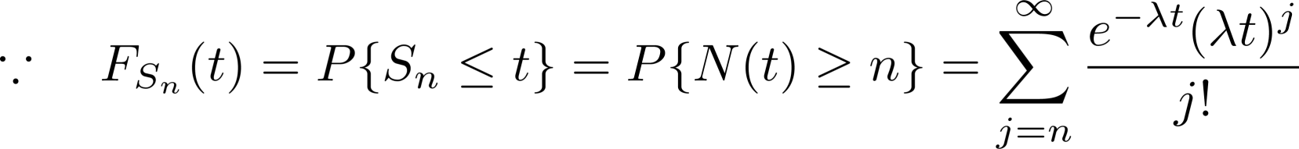
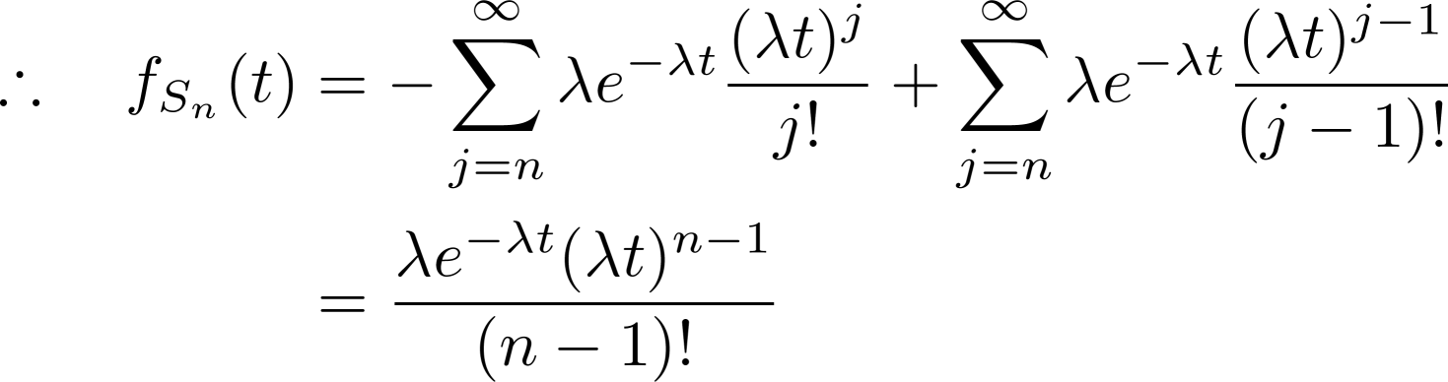
The Arrival Time Distribution of the
Event
Theorem
The arrival time of the event, (also called the waiting
time until the
Proof:
Method 1
event), is Erlang distributed with parameter (n, λ ).

Slide 25
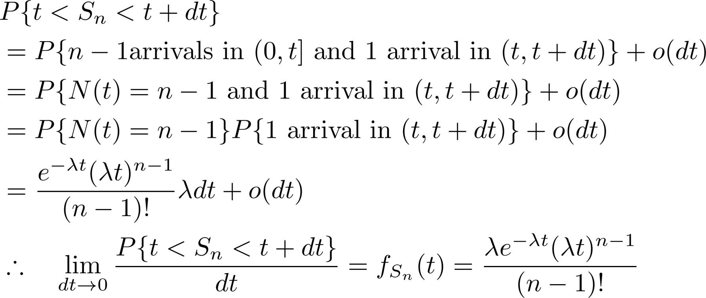
The Arrival Time Distribution of the n-th Event (con’t)
Method 2:
?
independent

Slide 26
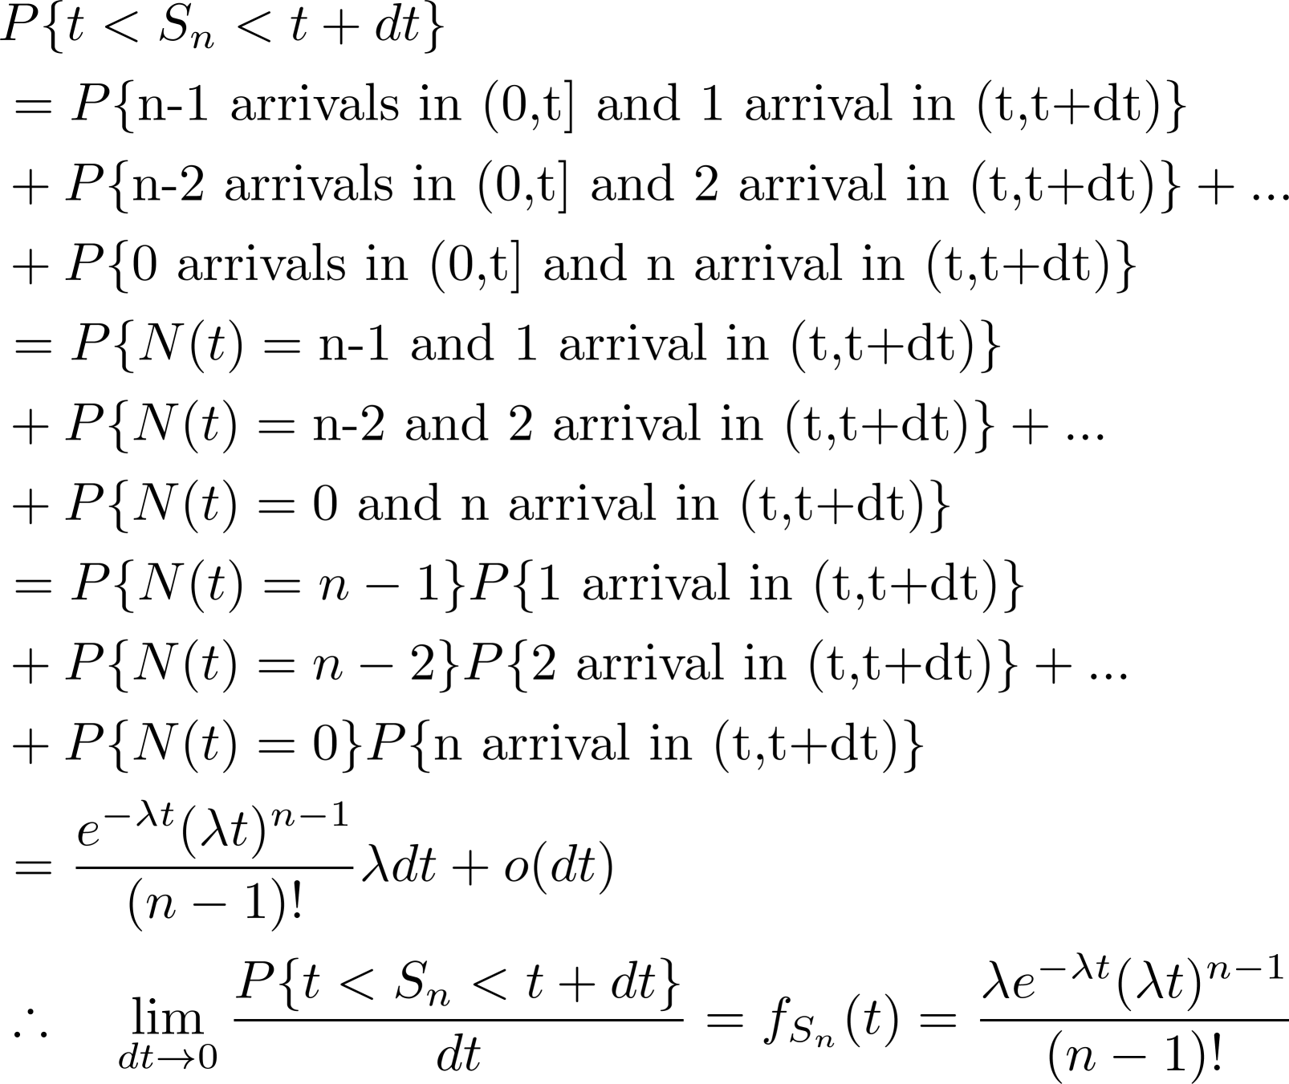
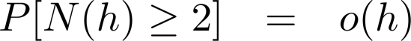
Erlang
26

Slide 27




Slide 28









Conditional Distribution of the Arrival Times Theorem Given that , the n arrival times have the same distribution as the order statistics corresponding to n i.i.d. uniformly distributed random variables from ( 0, t ). Order Statistics: Let be n i.i.d. continuous RVs having common pdf f . Define as the smallest value among all , i.e., then Y₍₁₎, …,Y_{(n)} are order statistics corresponding to random variables
 | Joint pdf of is where .
29

Slide 29

Conditional Distribution of the Arrival Times
Proof.
Stationary P{exact one in [t_{i},t_{i}+h_{i}]}
= P{exact one in[0,h_{i}]}
Independent
P{exact one in [t₁,t₁+h₁], exact one in [t₂,t₂+h₂]}
=P{exact one in [t₁,t₁+h₁]}P{exact one in [t₂,t₂+h₂]}

Slide 30



Conditional Distribution of the Arrival Times
f = 1/t (a uniform distribution)

Slide 31




Slide 32



Conditional Distribution of the Arrival Times

Slide 33




Slide 34


Example (Ex. 2.3(A) p.68 [Ross])
Suppose that travelers arrive at a train depot in accordance with a Poisson process with rate λ. If the train departs at time t, what is the expected sum of the waiting times of travelers arriving in (0,t)?
..........
t
S₁
S₂
S₂
^{S}N(t)

Slide 35



Solution
Let U₁, U₂, …, U_{n} denote a set of n independent uniform (0, t) RV, then
∵

Slide 36


∴
＃

Slide 37


solution
38

Slide 38



Superposition of Independent Poisson Processes
Theorem. Superposition of independent Poisson Processes (λi , i = 1, . . . , N ), is also a Poisson process with rate
Poisson Poisson λ2
λ1
Poisson
…
…
Poisson
λN
<Homework> Prove the superposition theorem.
(note that a Poisson process must satisfy Definitions 1 or 2)
39

Slide 39





Decomposition of a Poisson Process
Theorem
Given a Poisson process
If
represents the number of type-i events that occur by time
t, i = 1, 2;
Arrival occurring at time s is a type-1 arrival with probability p(s), and type-2 arrival with probability 1 − p(s)
40

Slide 40



Decomposition of a Poisson Process
p(s)
Poisson
Poisson λ
1-p(s)
Poisson
special case: If p (s) = p is constant, then
p
Poisson rate λp
Poisson λ
1-p
Poisson rate λ (1 − p)

Slide 41


Proof
(proof is n next slide)
Since the arrival time of the n+m events are independent (each is uniform (0,t] )
∴
just equal to the probability
of n successes and m failures independent tials with success probability p

Slide 42




＃

Slide 43



Slide 44

Example ( Infinite Server Queue, textbook [Ross])
Suppose that customers arrive at a service station in accordance with a Poisson process with rate λ. Upon arrival the customer is immediately served by one of an infinite number of possible servers, and the service times are assumed to be independent with a common distribution G.
type-1 customer: if it is complete its service by time t
type-2 customer: if it does not complete its service by time t
G
Poisson λ
departure

Slide 45

•
•
•
•
46

Slide 46


Solution
Any customer arrives at time s, s ≤ t, then it is a type-1 customer if its service time is less than t – s and the probability is
Theorem: Conditional Distribution of the Arrival Times => Uniform , iid

Slide 47




Theorem: Conditional Distribution of the Arrival Times

Slide 48

＃

Slide 49

Non-homogeneous Poisson Processes
(Relaxing Stationary Increment)
Theorem.
Proof. < Homework >.
52

Slide 50




Non-homogeneous Poisson Processes
Poisson
N(t+s) - N(t) is Poisson with mean m(t+s) - m(t)
λ(s)
t
t + s
Non- homogeneous Poisson process allows for the arrival rate to be a function of time λ(t) instead of a constant λ.
It is useful when the rate of events varies.
Ex: when observing customers entering a restaurant, the numbers will much greater during meal times than during off hours.

Slide 51




Example (Infinite Server Queue 2.4
(B) [Ross])
 | Poisson Arrival General service distribution Infinite server queue
Hint: Let interval (s, s +t ).
denote the number of service completions (departures) in the
To prove the above statement, we shall first show
follows a Poisson distribution with mean =
The numbers of service completions (departures) in disjoint intervals are independent, i.e., let
independent of
is

Slide 52


Proof (1)
Let an arrival event is type-1 if is departs in interval (s, s+t),
An arrival at y will be type-1 with probability

Slide 53


Slide 54
Proof (2)
Let I₁, I₂ denote disjoint time intervals.
An arrival is type-1 if it departs at I₁ An arrival is type-2 if it departs in I₂ Otherwise, it is type-3
According to the theorem of “Decomposition of a Poisson Process”, type-1 and type-2 are independent Poisson random variables.
It is “Non-homogeneous Poisson Processes.”

Slide 55

Example
60

